Slide 1


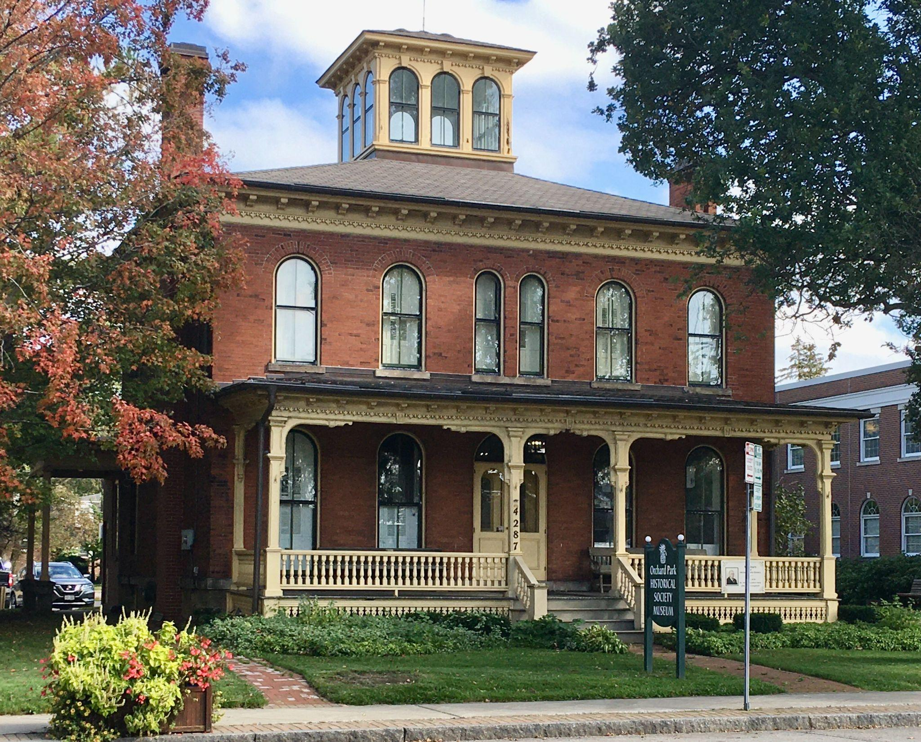
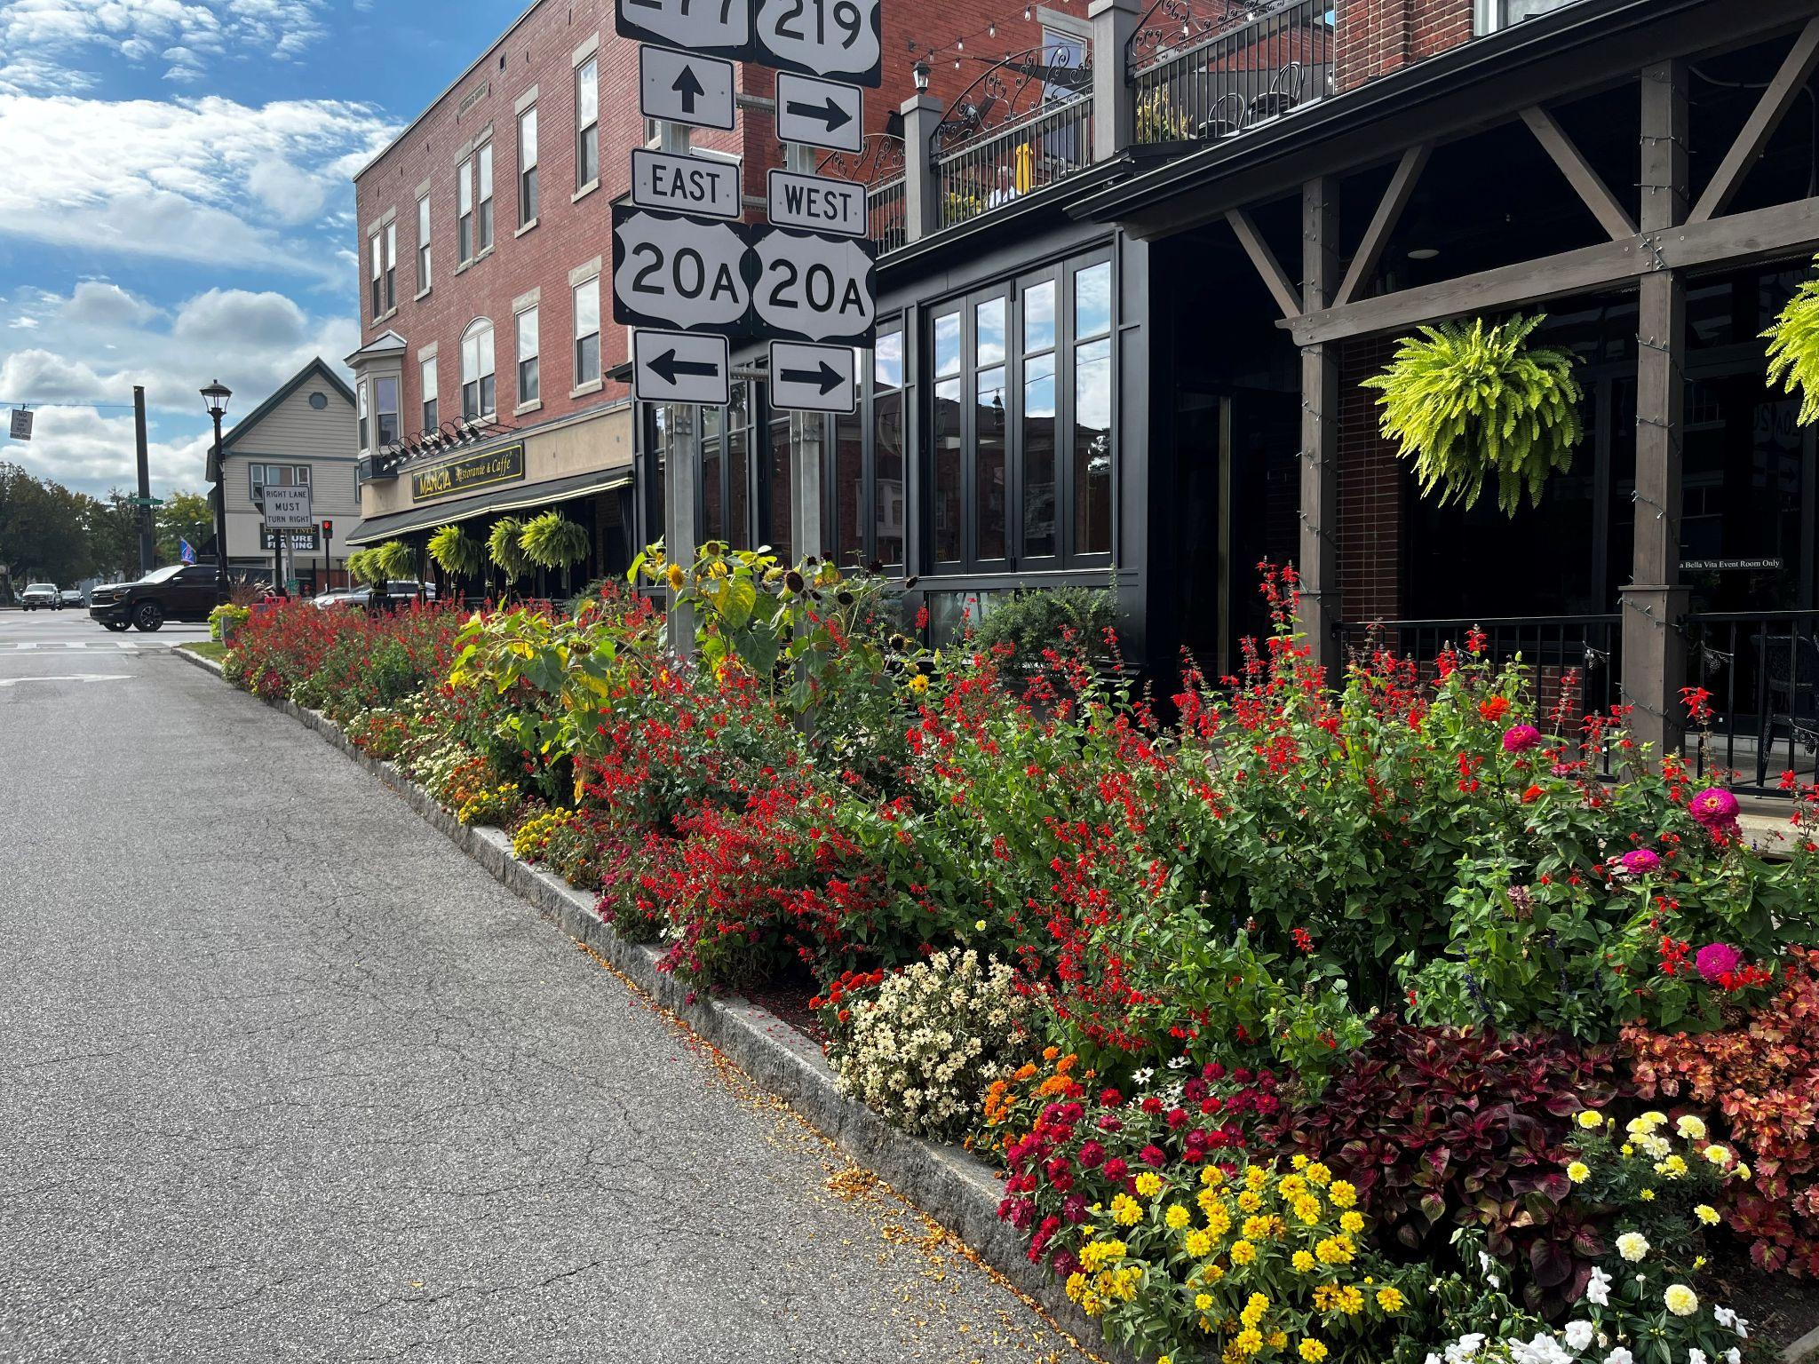
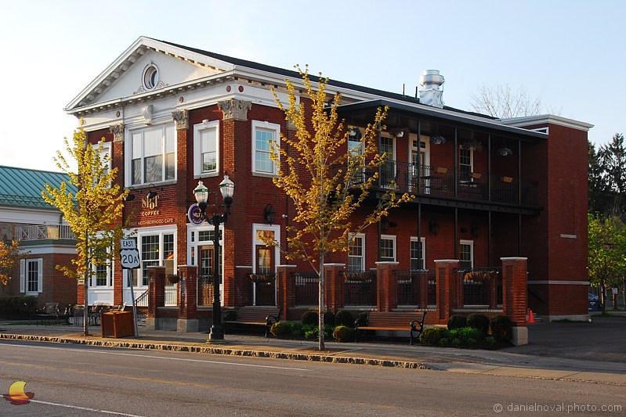
Village of Orchard Park
2026 Code Revision

Slide 2
The entire code was reviewed
Code sections that have proposed changes to the following Chapters:
169 Property Maintenance
225 Zoning
Adding significant changes
Design Standards
Landscape
Battery Storage
Off Street Parking

Slide 3
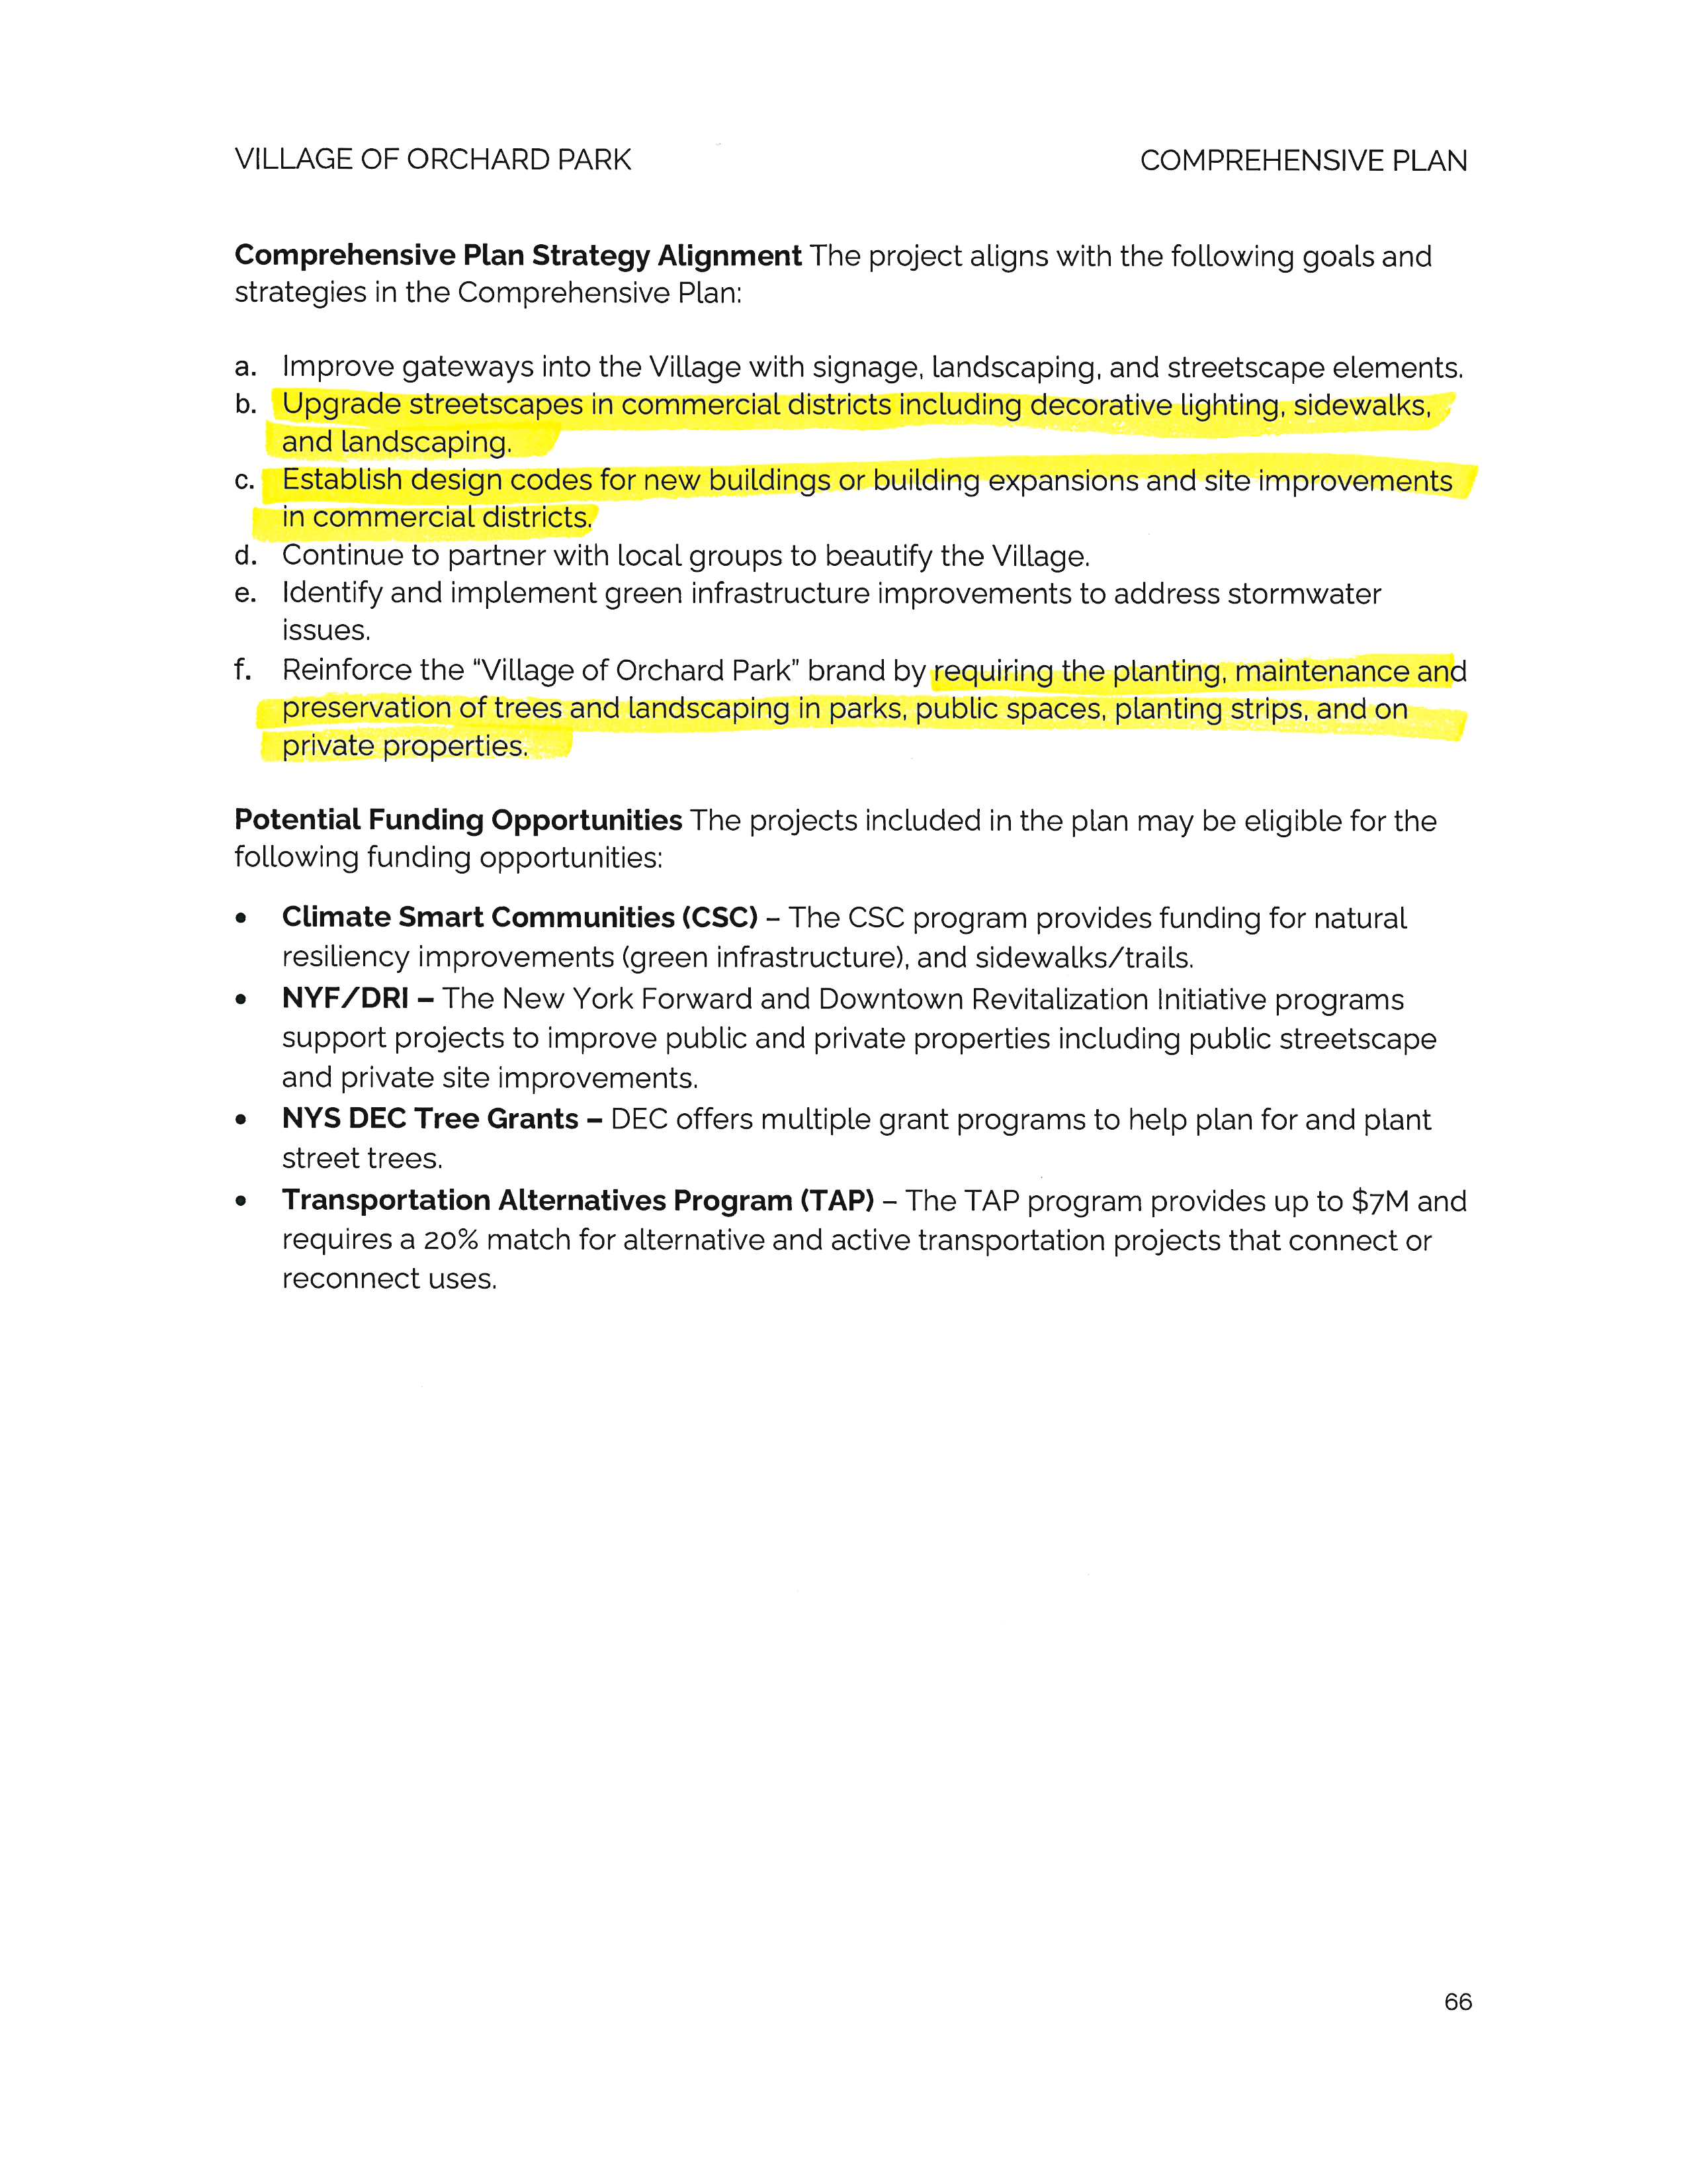
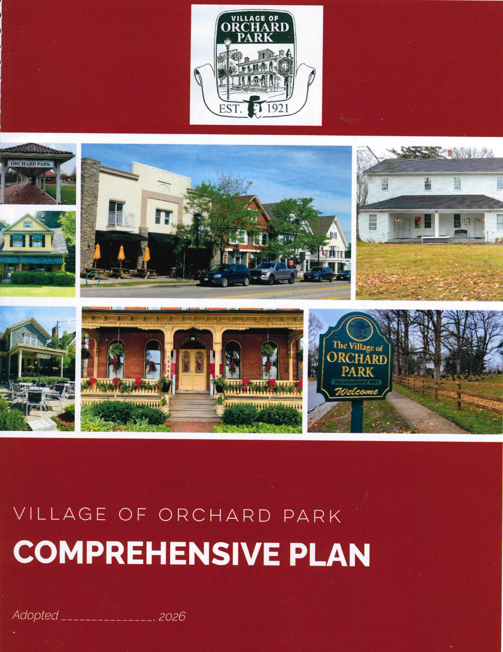
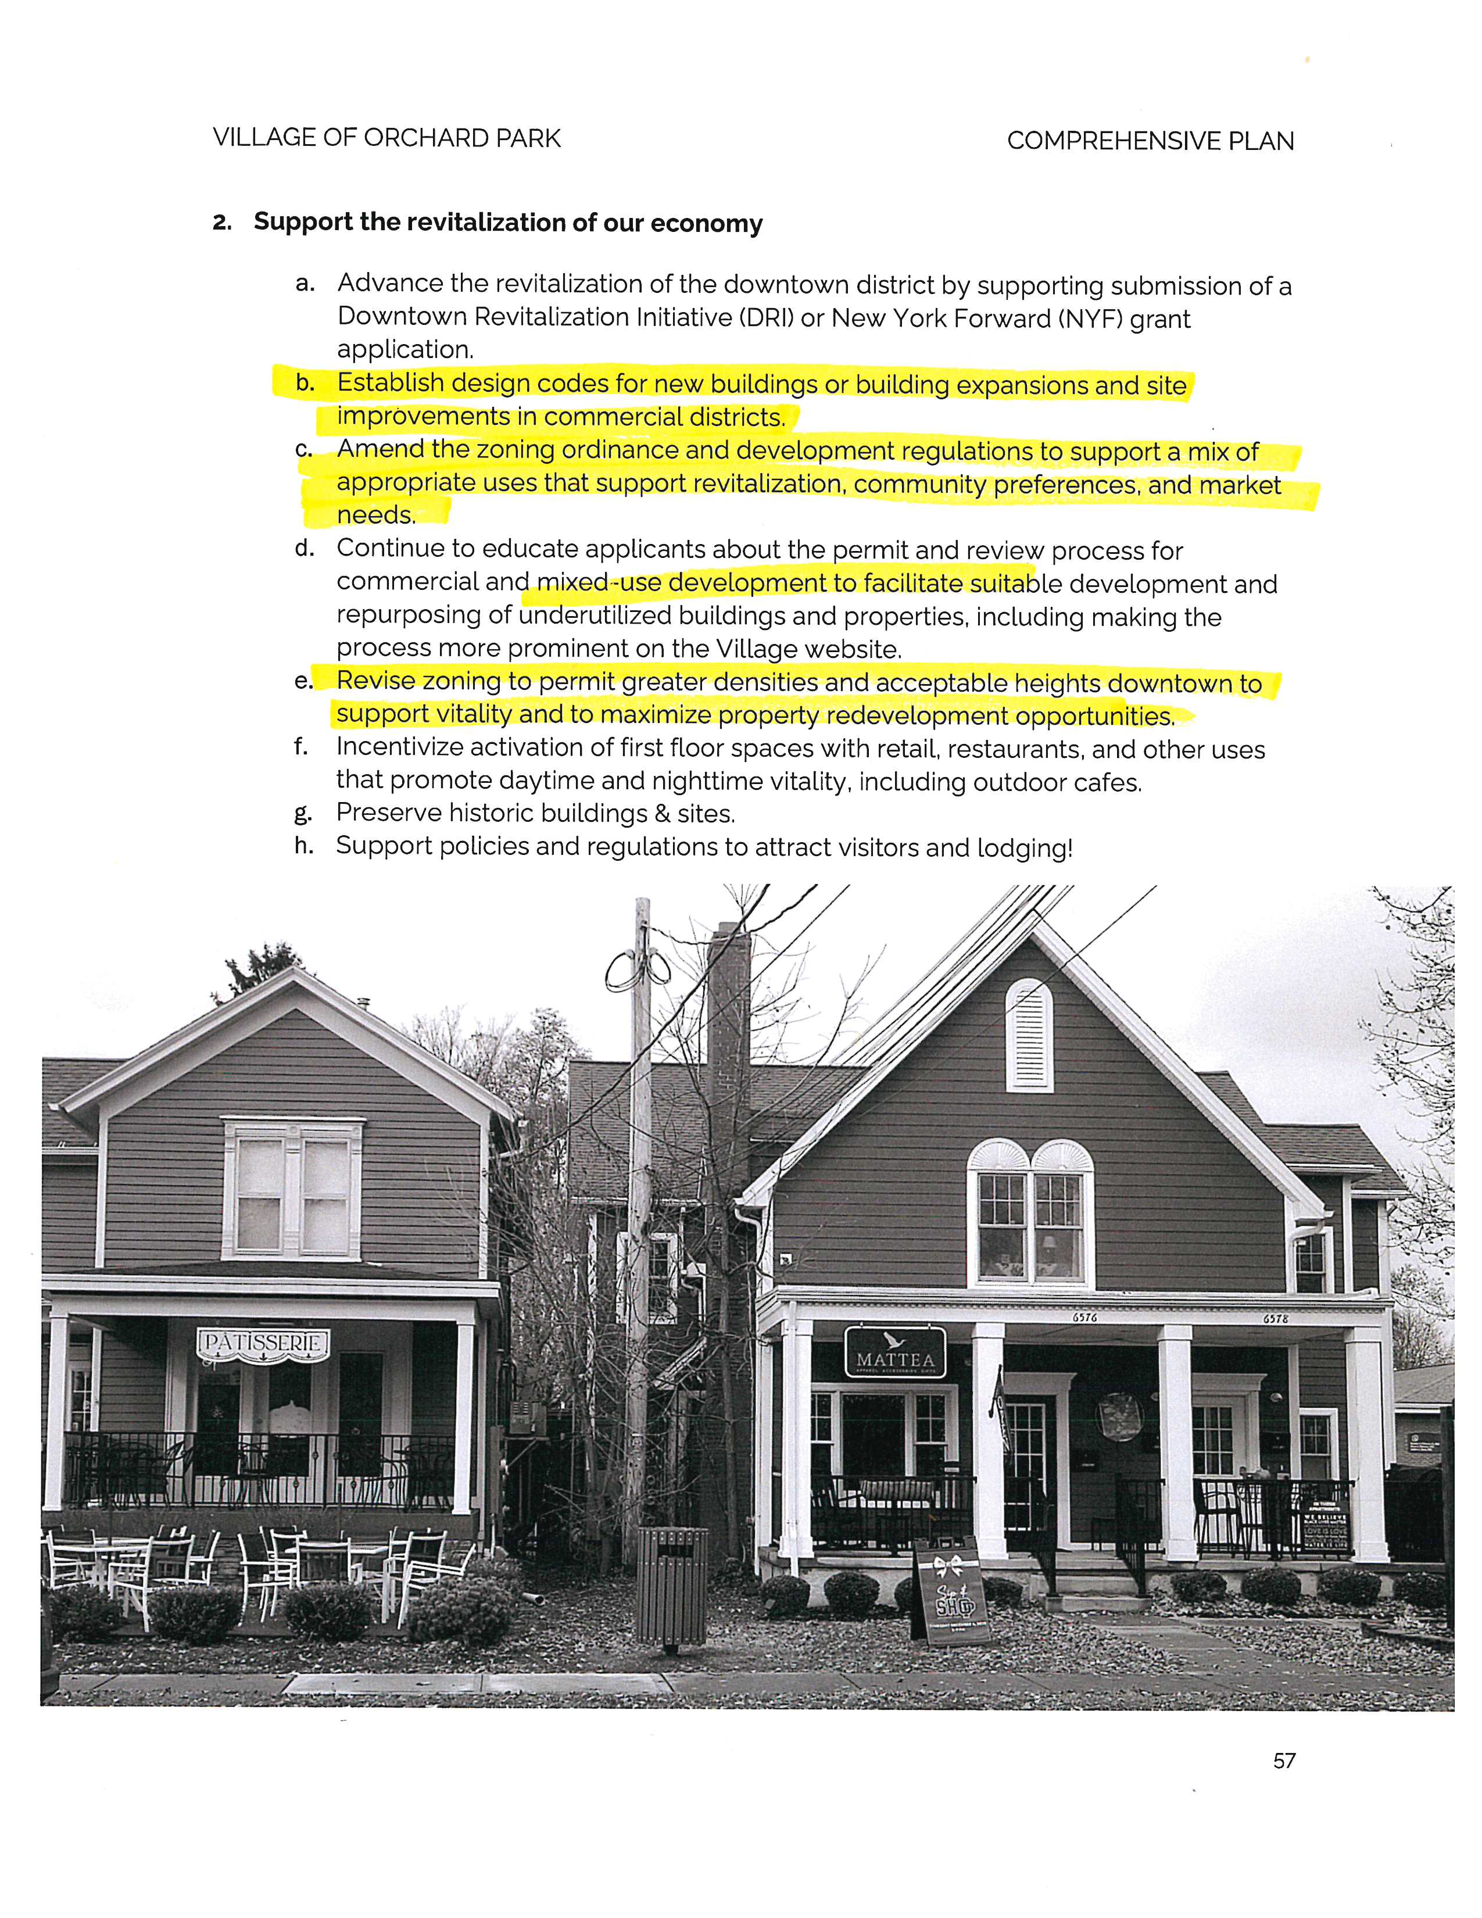
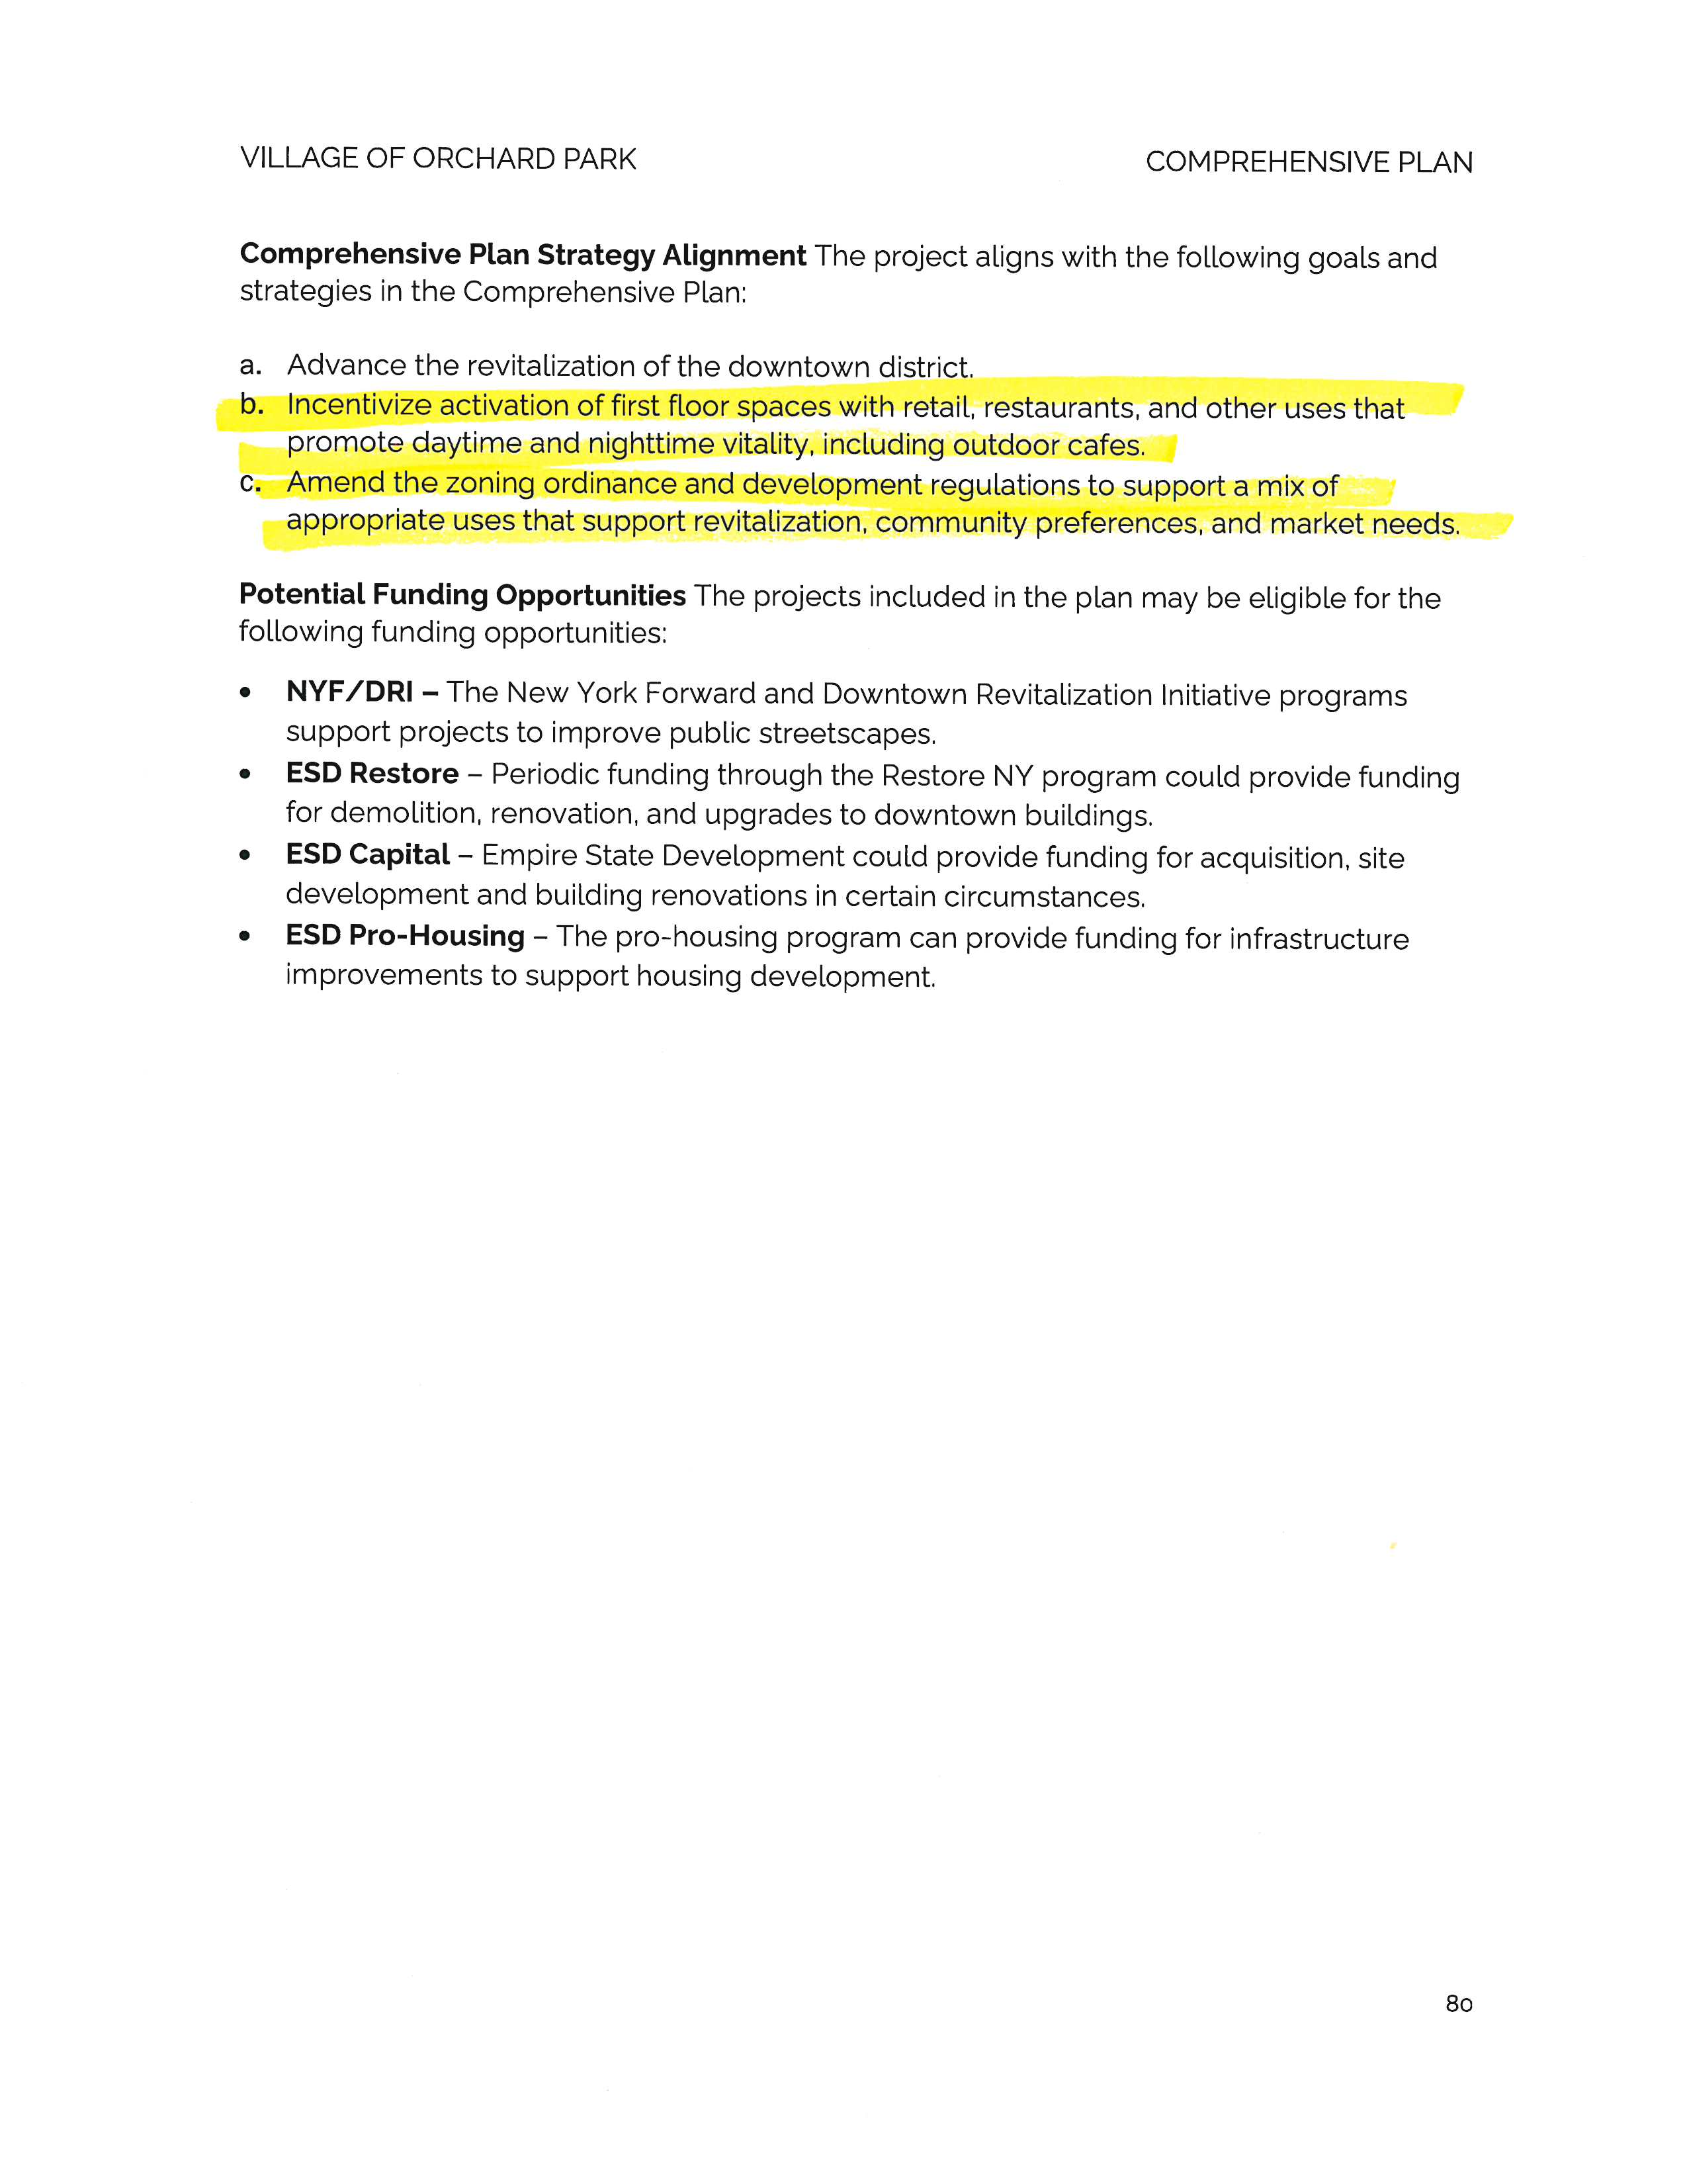
The entire code was reviewed

Slide 4

Code Updates
Chapter 169
Property Maintenance

Slide 5
Code Updates
Chapter 169
Adding all property maintenance violations which include the exterior within the boundaries will be treated as we do high grass

Slide 6

Code Updates
Chapter 225
Zoning Code

Slide 7
Code Updates
Chapter 225
Zoning Code
225-15 Current is deleted and is changed to Design Standards
225-18 Signs – section deleted and insert new text
225-36 New section for Battery Storage

Slide 8
Code Updates
Chapter 225
225-2 Legislative intent.
Pursuant to § 7-700 of the Village Law, the intent of this chapter is to establish comprehensive controls for the development of land in the Village of Orchard Park based on the general Comprehensive plan for the Village and enacted in order to promote and protect health, safety, comfort, convenience and the general welfare of the people.
225-3 Purposes.
Such regulations are made in accordance with the Comprehensive Plan and designed to lessen congestion in the streets, to secure safety from panic, fire, panic, floods, and other dangers; to promote the health and general welfare; to provide adequate light and air; to prevent overcrowding of land; to facilitate the provision of transportation, water, sewerage, schools, parks and other public requirements. Such regulations are made with reasonable consideration, among other things as to the characteristics of the district and its peculiarities for particular uses and with a view to conserving the value of buildings and encouraging the most appropriate use of land throughout the Village.

Slide 9
Code Updates
Chapter 225
225-5 Definitions.
BASEMENT
That portion of a building that is partly below grade and which has more than half of its height, measured from floor to ceiling, above the average established finished grade of the ground adjoining the building.
BED-AND-BREAKFAST FACILITY Short Term Rental
A dwelling in which overnight accommodations are provided or offered for compensation. The accommodations shall be contained within the confines of the principal building. Refer to 225 Attachment 1, Schedule I for allowable locations.

Slide 10
Code Updates
Chapter 225
225-5 Definitions.
BOARDING HOUSE
Any dwelling in which more than three persons, either individually or as families, are housed or lodged for hire with or without meals. A lodging house, rooming house or furnished room house shall be deemed a boarding house.
BUILDING, PRINCIPAL
A structure in which is conducted the principal use of the site on which it is situated. In R-1 and R-2 Zones, only one principal building on a lot of record is permitted. In R-3, R-4, R-5, B-1, B-2 and I-1 Zones, more than one principal building on a lot of record is permitted as a special use. (See also "accessory building,")

Slide 11
Code Updates
Chapter 225
225-5 Definitions.
CELLAR
That portion of a building that is partly or entirely below grade and which has more than half of its height, measured from floor to ceiling, below the average established finished grade of the ground adjoining the building.
COMMUNITY FACILITIES PUBLIC UTILITIES
Public utilities and other essential community services, equipment structures and accessories reasonably necessary for the furnishing of gas, electricity, steam, water, communications, supply and disposal systems, and other similar community related systems or improvements for the promotion of public health, safety or general welfare.
DAY-CARE CENTER and/or DAY NURSERY
A place for the care only, of five or more children away from their own residence who stay for a period of three or more but less than 24 hours during any day irrespective of compensation, reward or otherwise.

Slide 12
Code Updates
Chapter 225
DWELLING A building used as the living quarters for one or more families, but not including a boarding house, hotel, lodging house, motel or rooming house.
DWELLING, MULTIPLE A dwelling used or designed for use as a multiple dwelling as defined in the New York State Multiple Residence Law.
DWELLING
A building used as the living quarters for one or more families, but not including a building of mixed occupancy.
A. SINGLE-FAMILY DWELLING A building containing one dwelling unit and designed or used exclusively for occupancy by one family.
B. TWO-FAMILY DWELLING A building containing two dwelling units and designed or used exclusively for occupancy by two families living independently of each other; or two one-family dwellings having a party wall in common.
C. MULTIFAMILY DWELLING A building containing three or more dwelling units and designed or used for occupancy by three or more families living independently of each other.

Slide 13
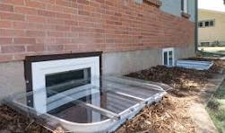
Code Updates
Chapter 225
EMERGENCY EGRESS WINDOW - BASEMENT
A basement emergency egress window is a code-compliant, operable window designed as a secondary emergency exit for lower-level habitable spaces, such as bedrooms. It must be large enough for an adult to pass through, allowing safe escape or firefighter entry, as required in the New York State Building Code. These assemblies should be installed so as to meet the required setbacks in 225 Attachment 2 Schedule II

Slide 14
Code Updates
Chapter 225
HOME OCCUPATION An occupation or a profession customarily carried on in a dwelling unit, which Studio or office of a resident medical or osteopathic physician, dentist, chiropodist, podiatrist, physiotherapist, chiropractor, lawyer, engineer, architect, landscape architect, accountant, insurance agent or real estate agent, provided that:
A. Actually is carried on wholly within the principal building; and
B. Is carried on by only members of the family residing in the dwelling unit; and
C. Is clearly incidental and secondary to the use of the dwelling unit for residential purposes not exceeding 25% of said building, with no exterior display, no exterior storage of materials and no exterior indication of the home occupation or variation from the residential character of the principal building; and
D. Produces no offensive noise, vibrations, smoke, dust, odors, heat, glare or traffic hazard or congestion.
HOTEL A building other than a boarding house or tourist home Short-Term Rental, containing rooms which are rented or hired out for sleeping purposes by guests and where only a general kitchen and dining room are provided within the building.

Slide 15
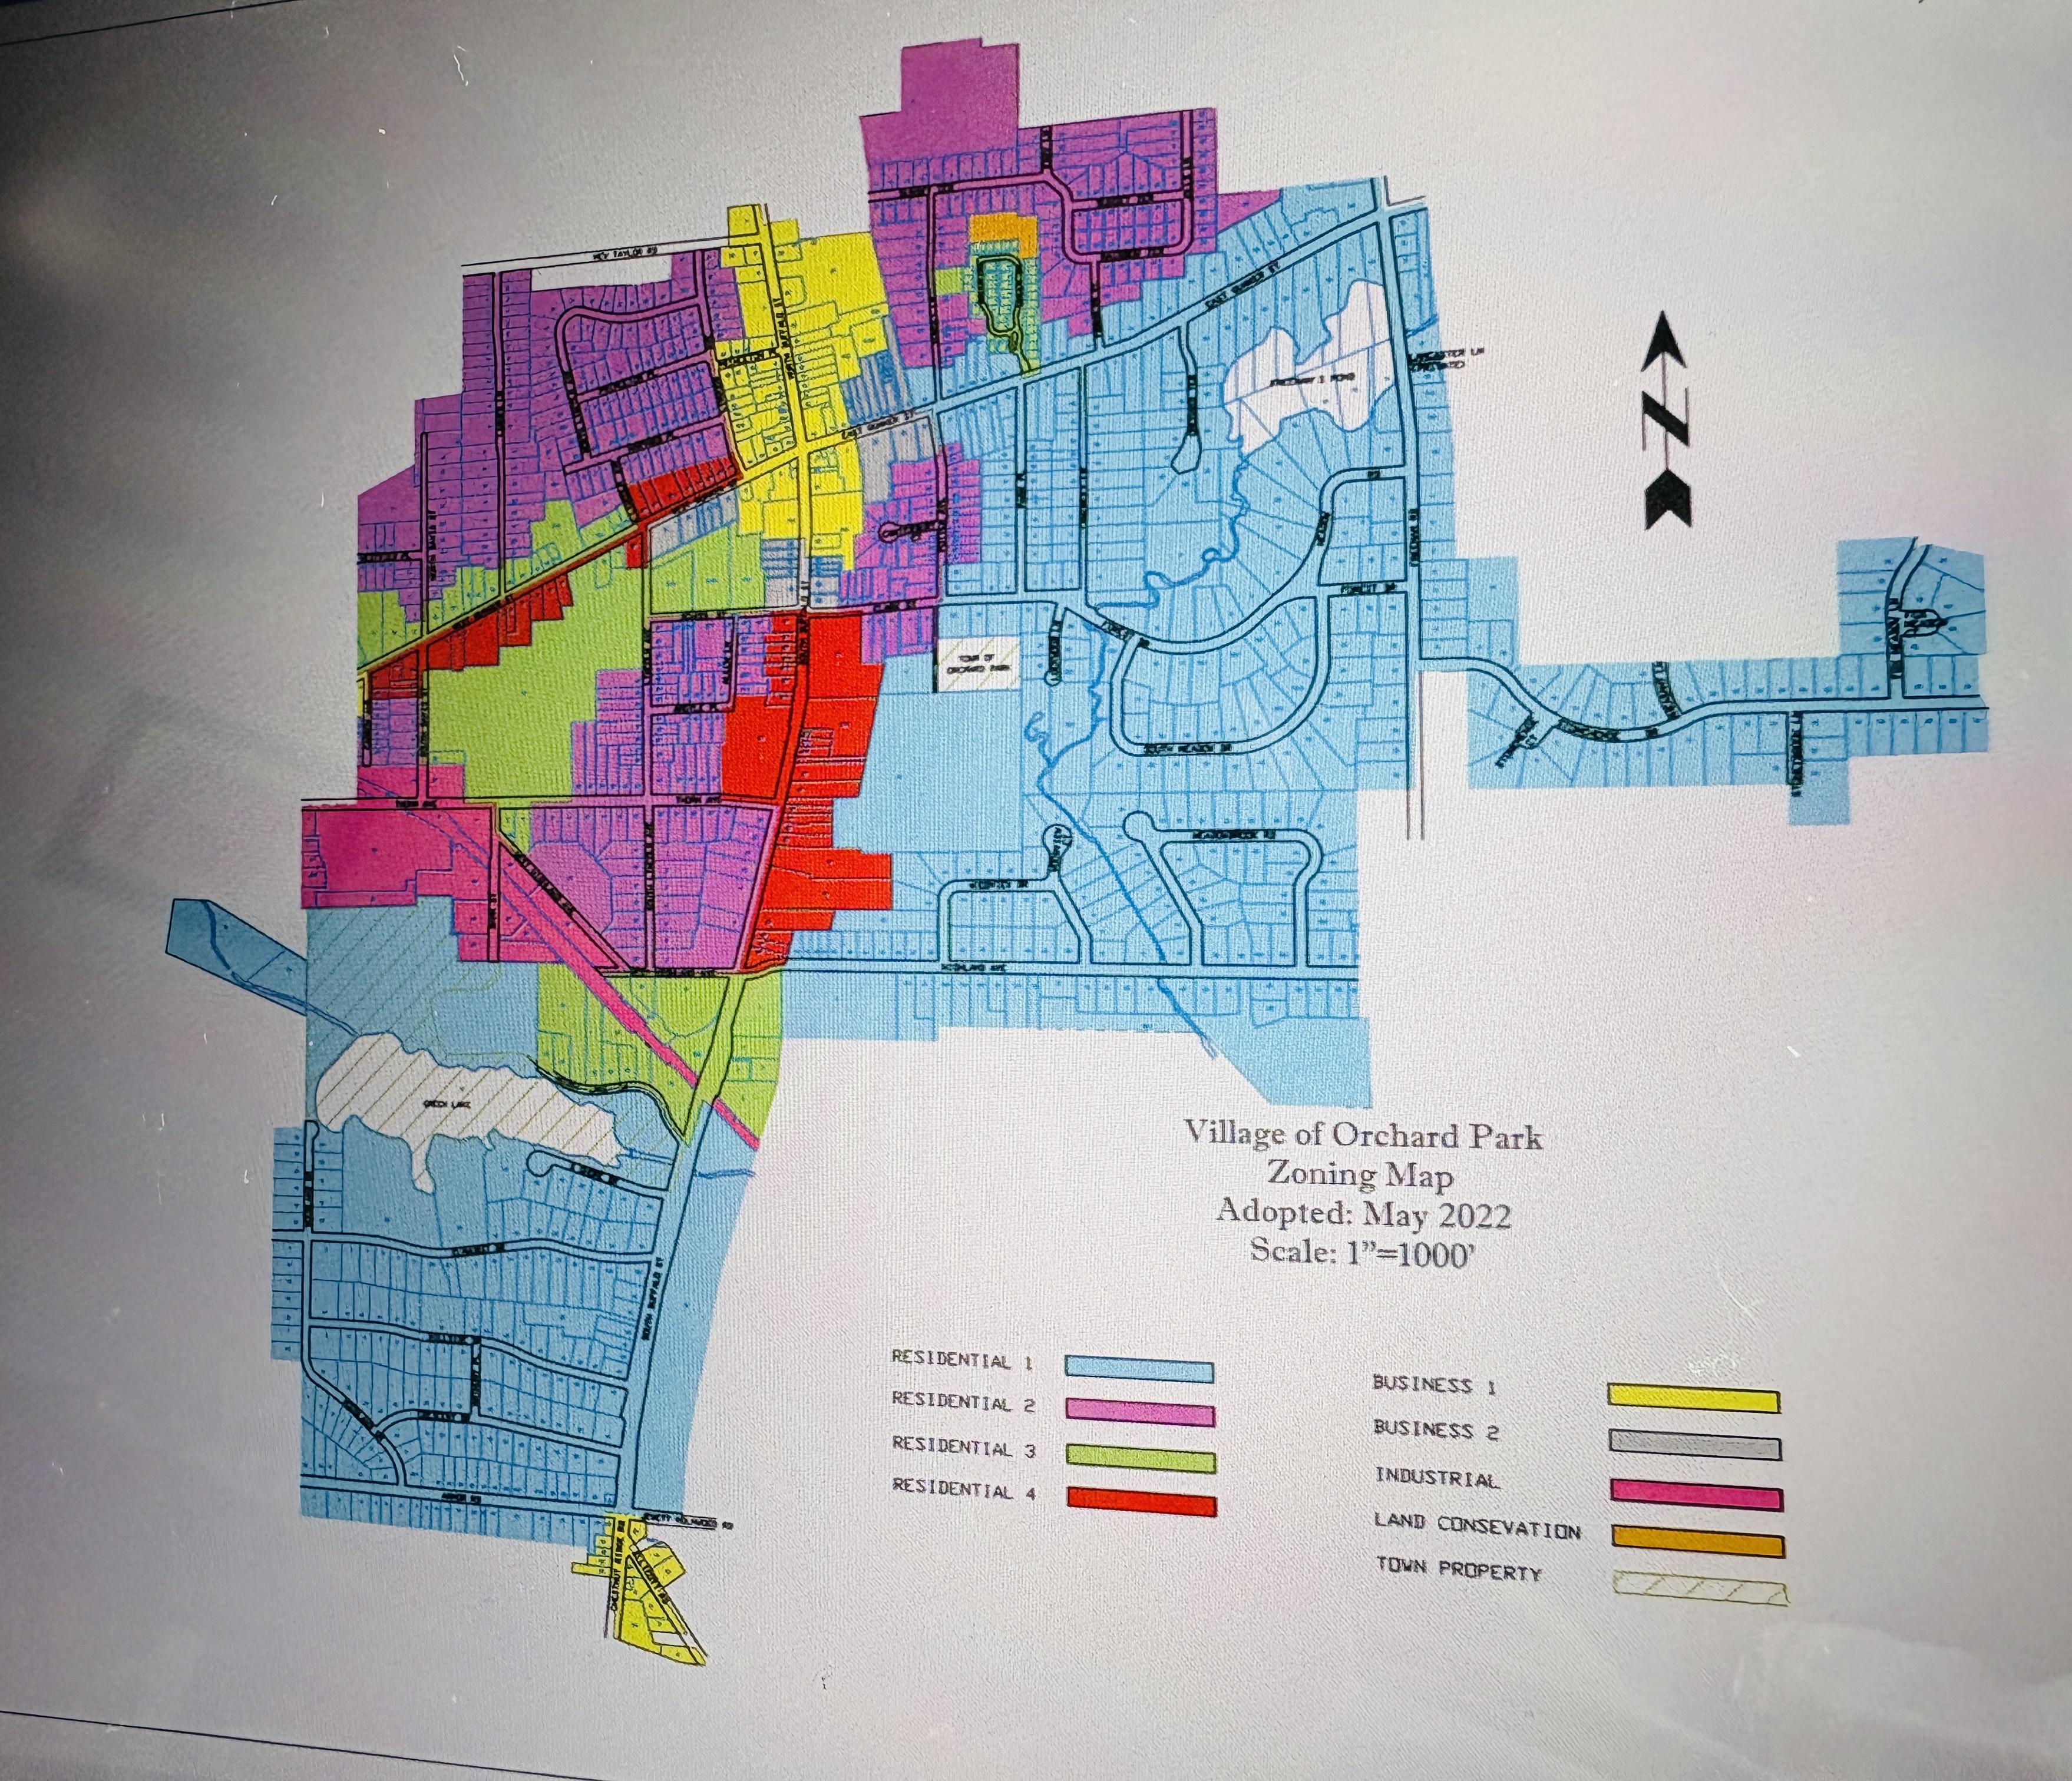
Code Updates
Chapter 225
Article II
225-7 Zoning Map.
The districts are bounded as shown on the map entitled, "1999 Zoning Map of the Village of Orchard Park," and certified by the Village Clerk-Treasurer, which accompanies and which, with all explanatory matter thereon, is hereby made a part of this chapter.

Slide 16
Code Updates
Chapter 225
225-11 Lot, height, yard and maximum coverage requirements.
(c) Front, exterior side yard and rear yards. No structure shall be constructed on a nonconforming lot unless it shall have front and rear yards conforming to the minimums required for the R-District in which said lot is located.
225-11 Lot, height, yard and maximum coverage requirements.
225-11 C (4) Side yards.
(a)
Exterior side yard Side yard of a corner lot. The exterior side yard of any corner lot of record at the time of the adoption of this chapter shall have a setback matching the front yard setback. width equal to not less than 1/2 the required minimum front yard setback of any adjoining lot fronting on the side street. Any corner lot delineated by subdivision after the adoption of this chapter shall have a side yard equal in width to the minimum front yard setback of any adjoining lot fronting on the side street.

Slide 17
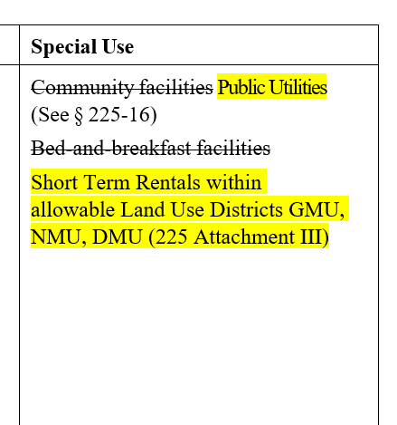
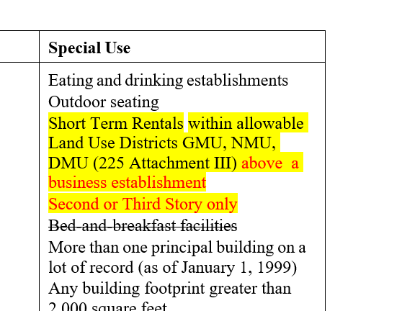
Code Updates
Chapter 225
Schedules

Slide 18
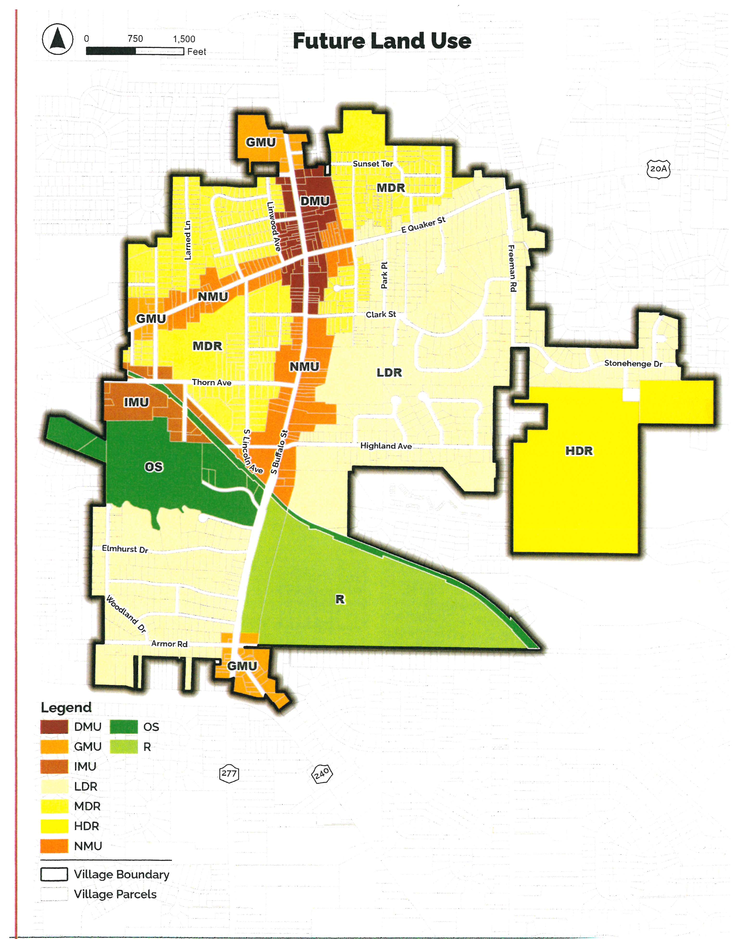
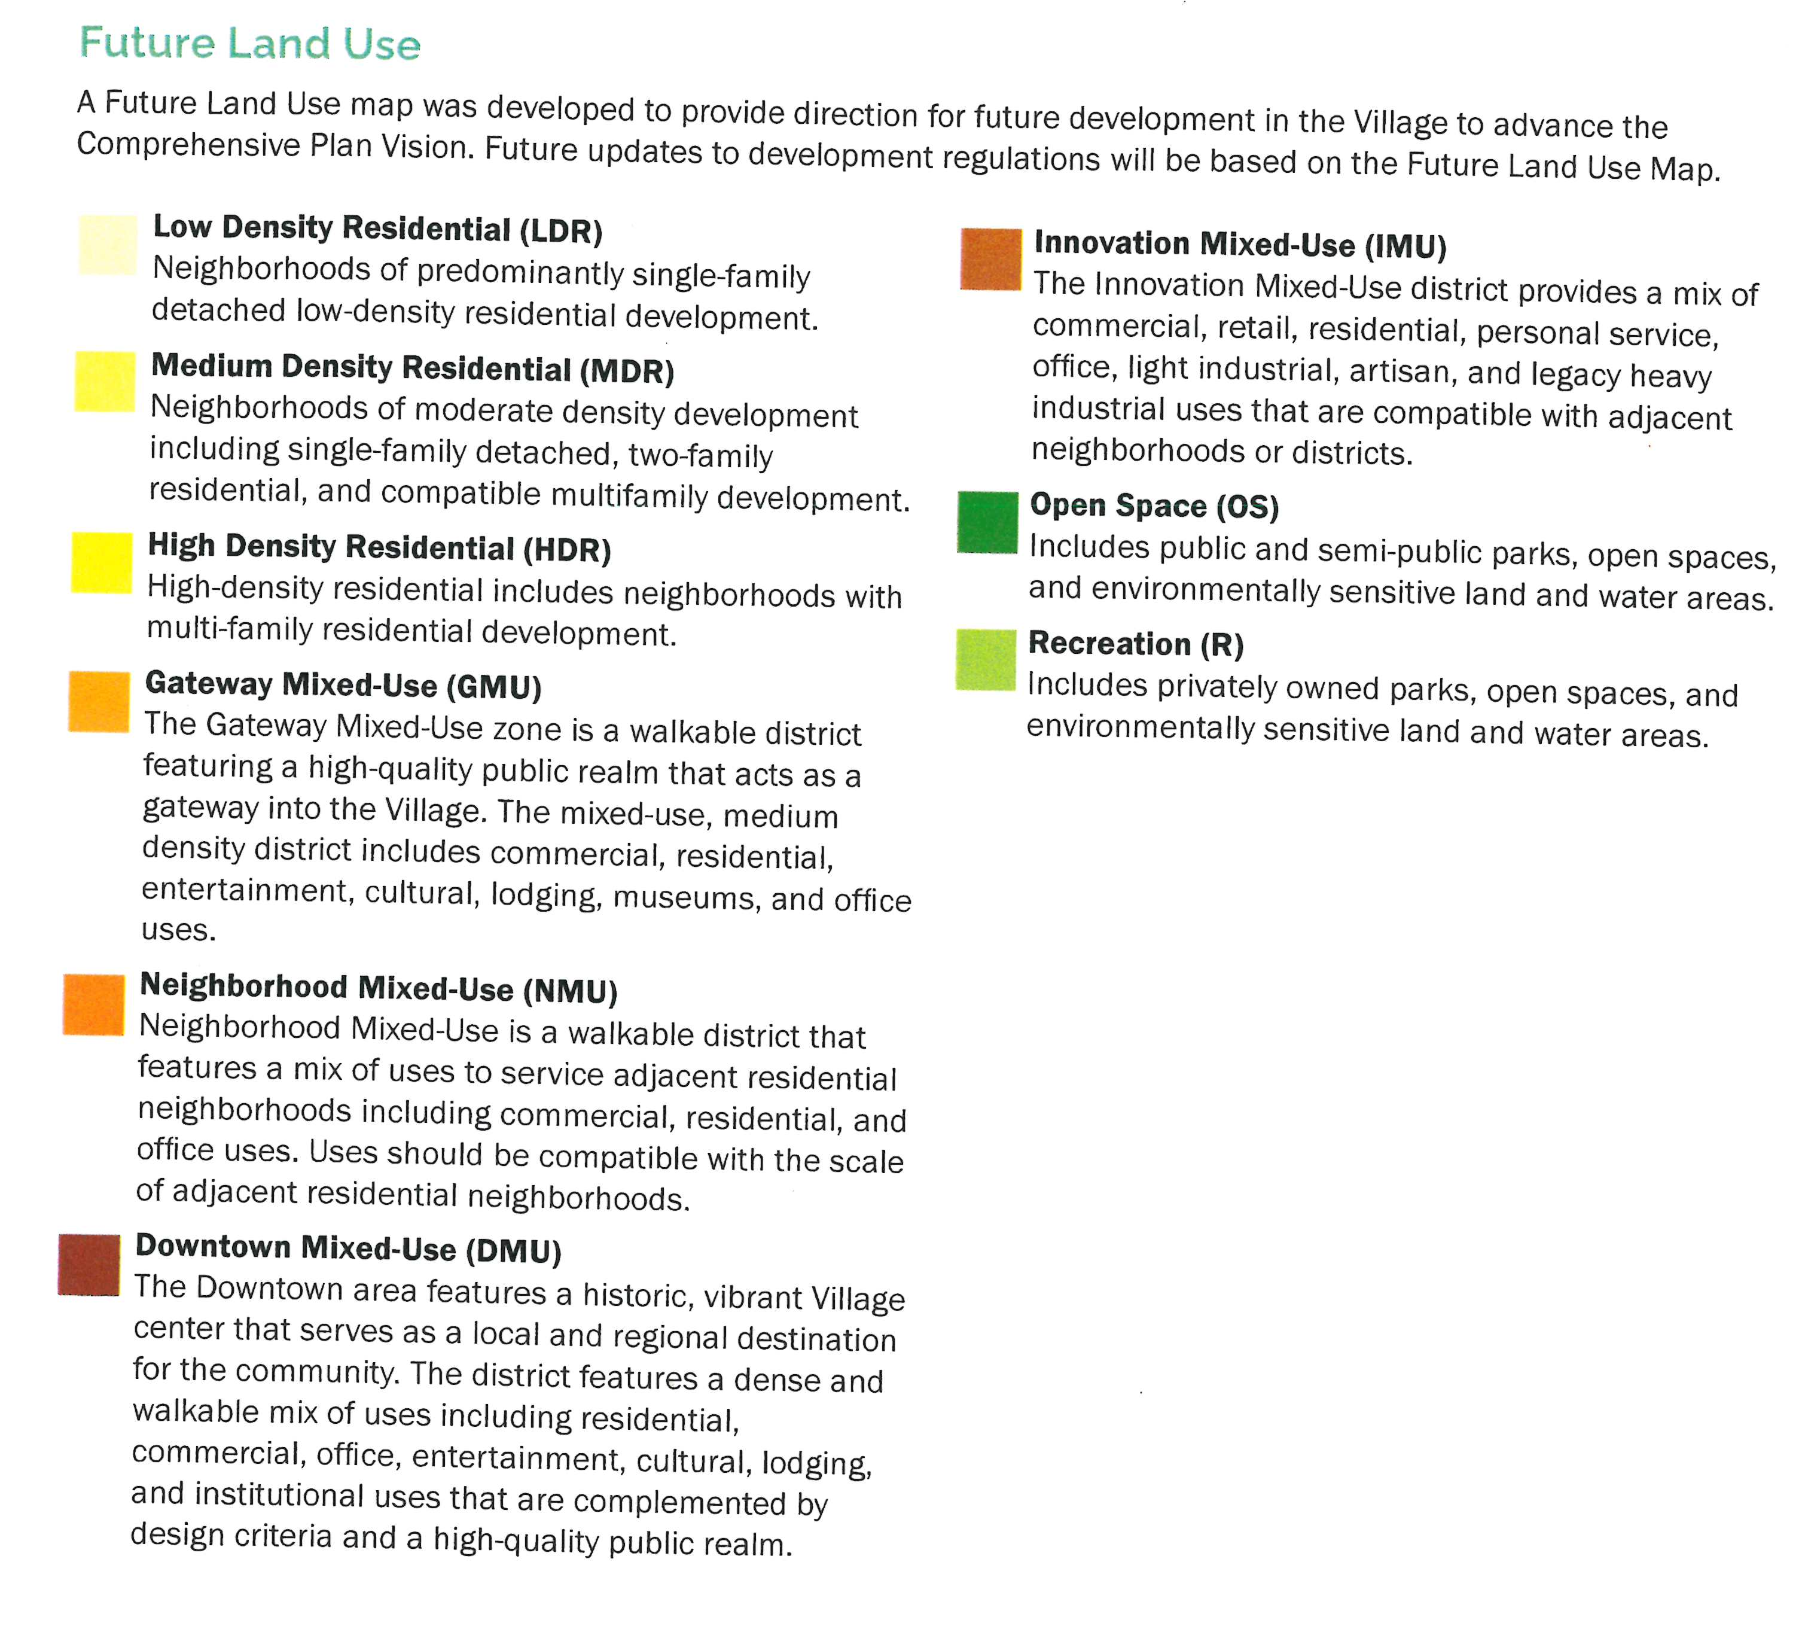
Code Updates

Slide 19
Code Updates
Chapter 225
Signs
The Sign ordinance was revamped entirely. Took some of the requirements then enhanced to make it easier.
What is required | What is the process | How to file
Definitions | How to measure | Construction type
What the sign should look like | Quantity of signs per lot | Colors
Illumination | Prohibited signs | Lawn signs
Regulations in districts | Where to locate

Slide 20
Code Updates
225-18.6 Prohibited signs.
The following signs are prohibited within the Village:
E. Signs placed on a curb, sidewalk, hydrant, utility pole, trees or other objects located on or over any public street unless otherwise permitted. The Village reserves the right to remove any sign placed on public property without notice.
G. Signs that flash, blink, rotate, or revolve, or utilize unshielded lighting devices or reflectors to outline or provide the background of a sign.
H. Signs that are animated or utilize full motion or video technology.
I. Signs that are mounted on wheels or mounted on any structure on wheels.
J. Signs with mirrors or any other reflective material.
K. Portable signs that are displayed.
L. Banners, pennants, or windblown or inflated signs that are permanently displayed.
M. Roof signs, obsolete signs, trailer signs and off-premises signs.
N. Signs painted directly on an exterior wall.
O. Banners or pennants. For the purposes of this article, banners or pennants shall be not be permitted as permanent or a temporary sign.

Slide 21
Code Updates
225-18.8 Temporary sign requirements.
A. Permit required. Temporary signs, as defined, shall require the issuance of a sign permit by the Code Enforcement Office. No more than one temporary sign may be permitted per lot or use at any given time. Temporary signs shall be permitted in all zoning districts.
B. Requirements. Any proposed temporary sign shall conform to the following:
(1) No sign shall be posted on public property except on signs maintained by the Village or other governmental authority.
(2) Temporary signs of charitable and nonprofit organizations. Temporary signs erected or maintained by charitable and nonprofit organizations may be permitted by the Code Enforcement Official upon direction of the Planning Board. The applicant must specify the number of signs to be erected, the size of the sign or signs, and the proposed location of the sign or signs. Any temporary sign shall be removed within 30 days. There shall be no fee for a permit for a temporary sign.

Slide 22
Code Updates
A. Ground signs.
Ground Sign: A sign not attached to any building or structure, which may be supported by one or two columns or posts provided the distance between the ground and bottommost edge of the sign is no greater than three feet
Zone | Residential Districts | Commercial Districts | Industrial Districts | N & S Buffalo Corridor
Maximum No. | 1 per lot | 1 per lot | 1 per lot | 1 per lot
Maximum Area | 6 square feet | 32 square feet | 32 square feet | 32 square feet with 10-foot setback; OR 24 square feet
Maximum Height¹ | 3 feet | 15 feet | 15 feet | 15 feet
Minimum Setback² | 5 feet | 10 feet | 10 feet | 0 feet; 10 feet for larger sign area
Illumination | Not Permitted | Permitted | Permitted | Permitted
NOTES:
(1) | Measured from the elevation of the ground at the center of the sign to the topmost edge of the sign.
(2) | Measured from the nearest edge of the sign to the front or side lot line.

Slide 23
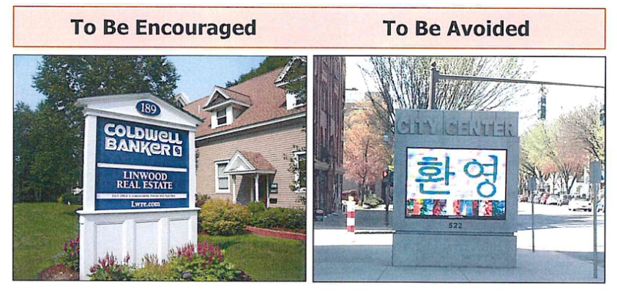
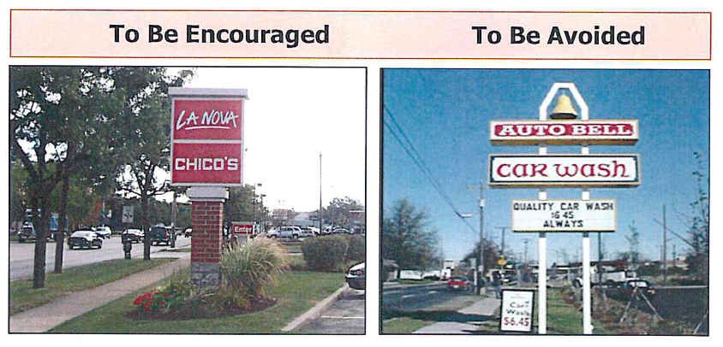
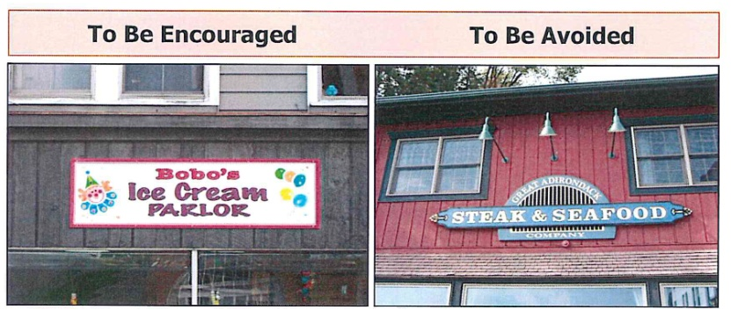
Code Updates
To Be Avoided
To Be Encouraged

Slide 24
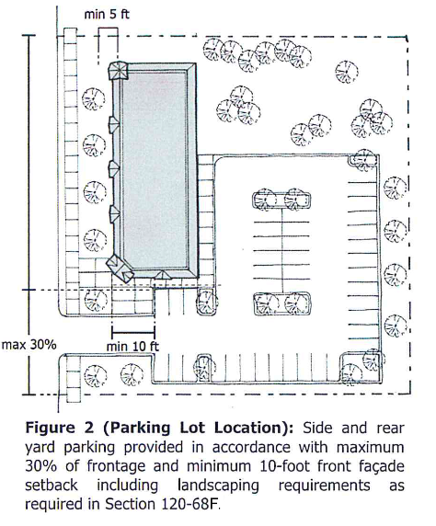
Code Updates
Off Street Parking
F. Shared parking.
(1) Shared parking is encouraged to promote efficient use of land and resources by allowing users to share off-street parking facilities for uses located within close proximity to one another with different peak parking demands or different operating hours (see Figure 3).
(2) The Planning Board may approve shared use of parking facilities located on the same property or on separate properties if, in the opinion of the Planning Board:
(a) A convenient pedestrian connection between the properties exists;
(b) The properties are within 500 feet of each other on the same side of the street or within 250 feet of each other on opposite sides of the street; and
(c) The availability of parking for all affected properties is indicated by approved directional signs.

Slide 25
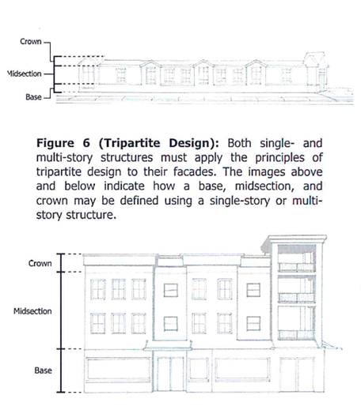
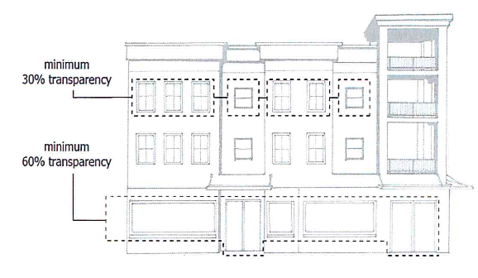
Code Updates
Nonresidential Design Standards and Guidelines

Slide 26
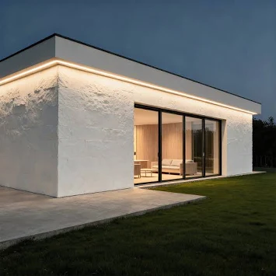
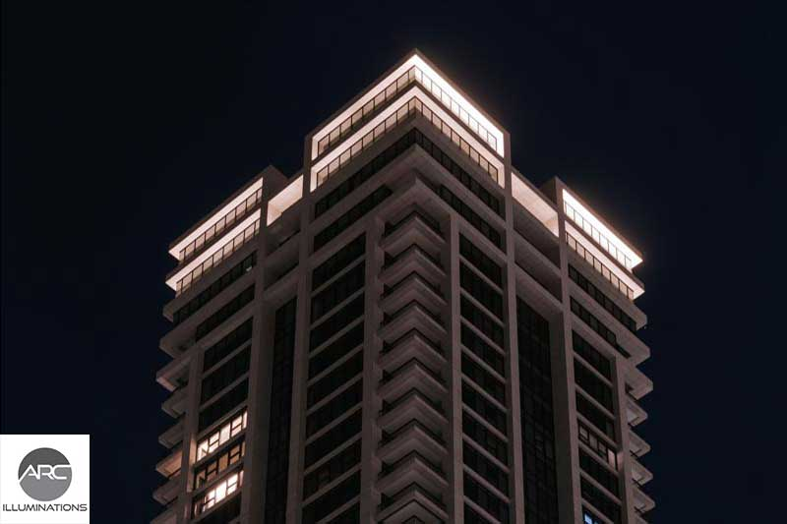
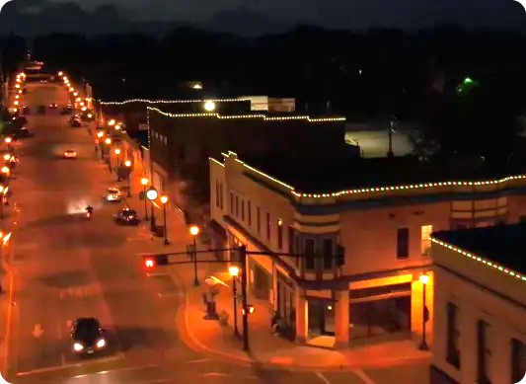
Code Updates
Nonresidential Design Standards and Guidelines

Slide 27

Code Updates
Battery Energy Storage Systems

Slide 28

Code Updates

